Slide 1
Lincoln Stocking Cross
LP# | Model | Description | LP# | Model | Description
236005 | PF91025 | 1/5HP THERMOPLAS SUB UTIL PUMP | 236035 | PF92511 | 1/2HP CI SUMP PUMP SIDE DISCHRG
236010 | PF91335 | 1/3HP THERMOPLAS SUB UTIL PUMP | 236040 | PF92333 | 1/3HP THERMOPLAS PED SUMP PUMP
236015 | PF92260 | 1/4HP THERMOPLAS AUTO SUMP PUMP | SO | PF92305 | 1/3HP CI EFFLUENT PUMP TETHERED
236017 | PF92342 | 1/3HP THERMOPLAS AUTO SUMP PUMP | 236045 | PF93501 | 1/2HP CI SEWAGE PUMP W/ FLOAT SWCH
SO | PF92330 | 1/3HP THERMOPLAS AUTO SUMP PUMP | 236046 | PF93511 | 1/2HP CI SEWAGE PUMP W/ VERT SWCH
SO | PF92330PB | 1/3HP PLAS SUMP PUMP W/ BSE | SO | PF93015 | SMPLX SEW PUMP KIT W/ PF93501 PUMP
SO | PF92370 | 1/3HP TPLAS SUMP PUMP TETHERED SWCH | SO | PF93020 | SMPLX SEW PUMP KIT W/ PF93511 PUMP
SO | PF92331 | 1/3HP CI SUB SUMP PUMP W/ SWCH | 236013 | PF92017 | REMOTE LDRY DRN PUMP SYS
236020 | PF92341 | 3/10HP CI SUB SUMP PUMP W/ VERT SWC | SO | PF92941 | 12V BATRY BU PUMP SYS W/ PF92341
236025 | PF92352 | 1/3HP CI SUB SUMP PUMP SIDE DISCHRG | SO | PF92952 | 12V BATRY BU PUMP SYS W/ PF92352
236030 | PFTG92352 | 1/3HP CI SUB SUMP PUMP W/ABS DISC | 236060 | PF92910 | 12V BATRY BU PUMP ONLY KIT
SO | PFTG92352P | 1/3HP CI SUMP PUMP W/ BSE PIPE PVC

Slide 2
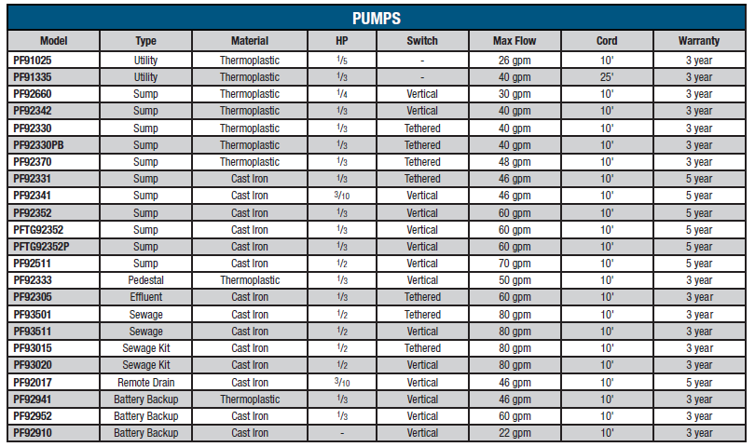
PROFLO Pump Comparison

