Slide 1
PROFLO Pumps

Slide 2
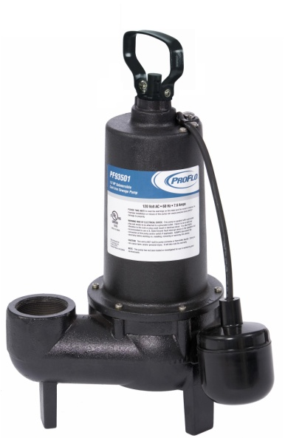
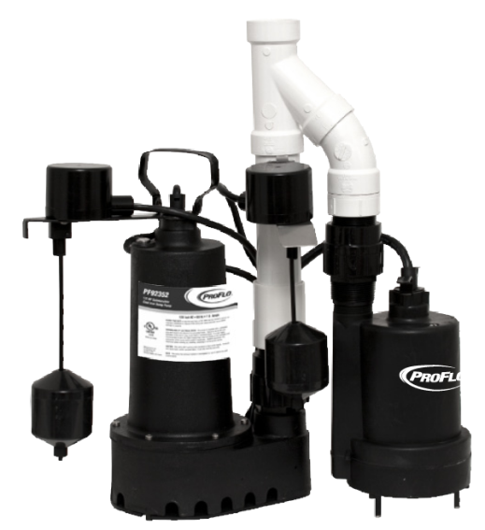
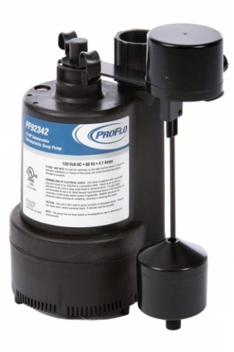
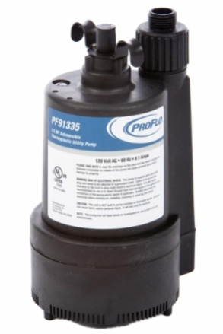
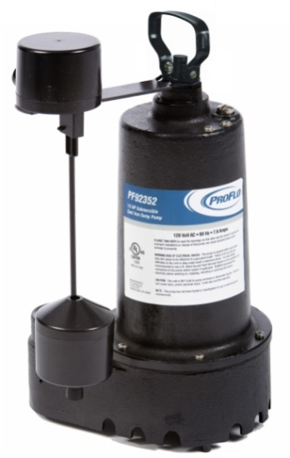
Types of PROFLO Pumps
Utility
Sump
Effluent
Sewage
Battery Backup Pumps

Slide 3
Lincoln Stocking Cross
LP# | Model | Description | LP# | Model | Description
236005 | PF91025 | 1/5HP THERMOPLAS SUB UTIL PUMP | 236035 | PF92511 | 1/2HP CI SUMP PUMP SIDE DISCHRG
236010 | PF91335 | 1/3HP THERMOPLAS SUB UTIL PUMP | 236040 | PF92333 | 1/3HP THERMOPLAS PED SUMP PUMP
236015 | PF92260 | 1/4HP THERMOPLAS AUTO SUMP PUMP | SO | PF92305 | 1/3HP CI EFFLUENT PUMP TETHERED
236017 | PF92342 | 1/3HP THERMOPLAS AUTO SUMP PUMP | 236045 | PF93501 | 1/2HP CI SEWAGE PUMP W/ FLOAT SWCH
SO | PF92330 | 1/3HP THERMOPLAS AUTO SUMP PUMP | 236046 | PF93511 | 1/2HP CI SEWAGE PUMP W/ VERT SWCH
SO | PF92330PB | 1/3HP PLAS SUMP PUMP W/ BSE | SO | PF93015 | SMPLX SEW PUMP KIT W/ PF93501 PUMP
SO | PF92370 | 1/3HP TPLAS SUMP PUMP TETHERED SWCH | SO | PF93020 | SMPLX SEW PUMP KIT W/ PF93511 PUMP
SO | PF92331 | 1/3HP CI SUB SUMP PUMP W/ SWCH | 236013 | PF92017 | REMOTE LDRY DRN PUMP SYS
236020 | PF92341 | 3/10HP CI SUB SUMP PUMP W/ VERT SWC | SO | PF92941 | 12V BATRY BU PUMP SYS W/ PF92341
236025 | PF92352 | 1/3HP CI SUB SUMP PUMP SIDE DISCHRG | SO | PF92952 | 12V BATRY BU PUMP SYS W/ PF92352
236030 | PFTG92352 | 1/3HP CI SUB SUMP PUMP W/ABS DISC | 236060 | PF92910 | 12V BATRY BU PUMP ONLY KIT
SO | PFTG92352P | 1/3HP CI SUMP PUMP W/ BSE PIPE PVC

Slide 4
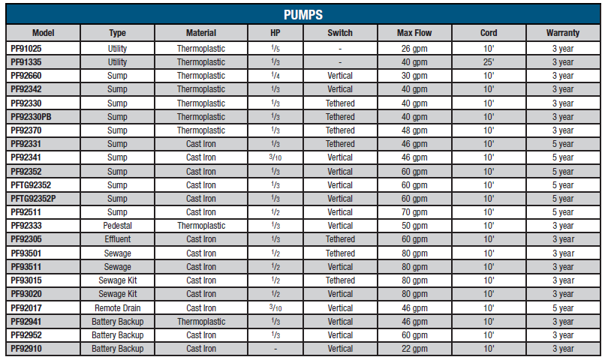
PROFLO Pump Comparison

Slide 5
PUMP TERMINOLOGY
Pump Head - refers to how high a pump will vertically lift water.
Split Capacitor Motors - Used in all PROFLO Pumps feature dual ball bearings and require less amp draw therefore run cooler and last longer.
GPMs - Gallons per Minute. How many gallons are pumped out of a basin per minute.
Solids Handling - The size of solids a pump can pass.
Discharge size - Determines the pipe size required for the pump to discharge the water or sewage
Impeller - Is a rotor blade positioned near the bottom of the pump which creates the process of water movement and subsequent water removal.
Housing/Base - The housing is the material of the top half of the pump. The base is the lower portion. All PROFLO Cast Iron pumps have cast iron housings and bases.
Notes:
REMOVE SLIDE???

Slide 6
UNIQUE FEATURES OF PROFLO PUMPS
Underwriters Laboratories (UL) Listed
Split Capacitor Motors
Double O-Ring Seals
SS Jacketed Double Lip Shaft Seals
Solid Copper Windings

Slide 7
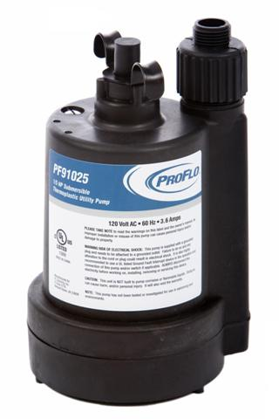
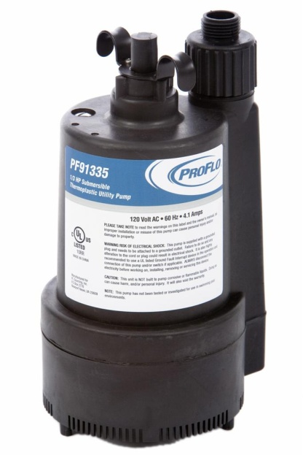
Proflo utility pumps
236005/PF91025 - 1/5HP THERMOPLAS SUB UTILITY PUMP
236010/PF91335 - 1/3HP THERMOPLAS SUB UTILITY PUMP
Continuous duty, thermally protected split capacitor motors
Pump will lift water over 25'
Low suction clearance - pumps to 1/8" of the floor
Pre fitted with garden hose adapter
Sleek design allows pump to fit in a 6" opening
For basic ground water removal

Slide 8
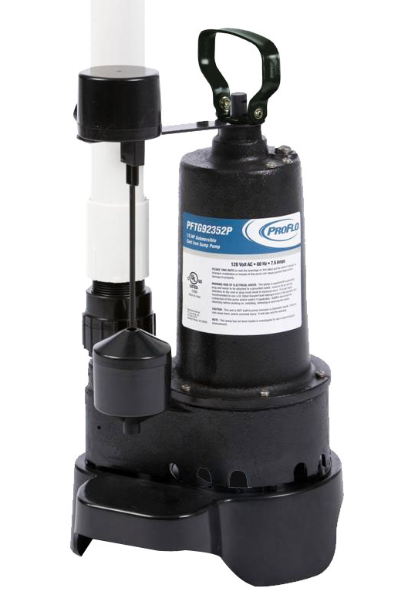
Proflo sump pumps
Split Capacitor Motors for low amp draw and cooler operation
Side and bottom intake for clog resistant suction
Vertical or tethered float switches available with piggy back plug included
Cast Iron and Thermoplastic designs available
Pump will lift water over 25’ vertical height
For basic ground water removal

Slide 9
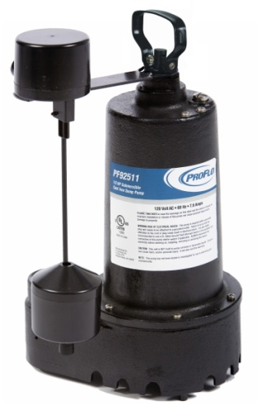
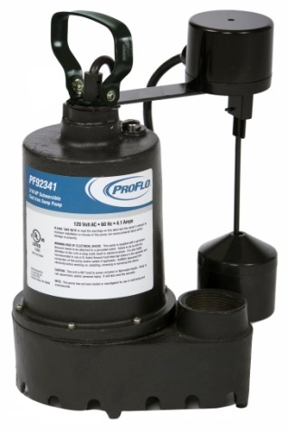
PROFLO SUMP PUMPS
236020/PF92341 3/10 HP Cast Iron submersible sump pump with side discharge, vertical float and 10’ cord. Pumps up to 46 GPM.
236025/PF92352 1/3 HP Cast Iron submersible sump pump with side discharge, vertical float and 10’ cord. Pumps up to 60 GPM.
236035/PF92511 1/2 HP Cast Iron submersible sump pump with side discharge, vertical switch and 10’ cord. Pumps up to 70 GPM.

Slide 10
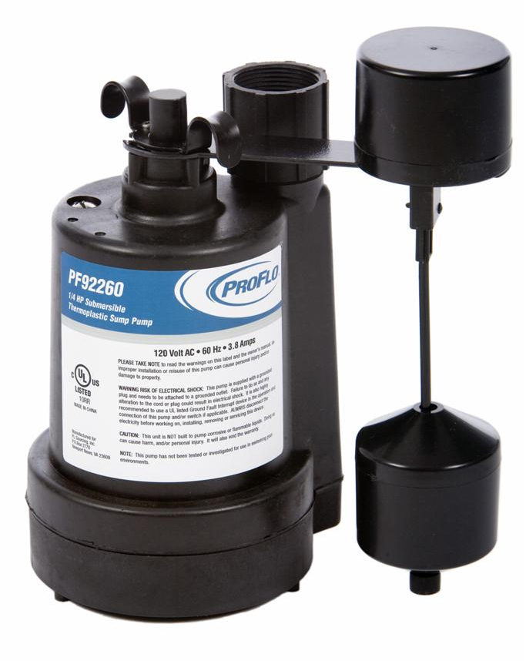
Proflo sump pumps - thermoplastic
236015/PF92260 1/4 HP Thermoplastic submersible sump pump with tethered switch. Pumps up to 30 GPM.
236017/PF92342 1/3 HP Thermoplastic submersible sump pump with vertical switch. Pumps up to 40 GPM.

Slide 11
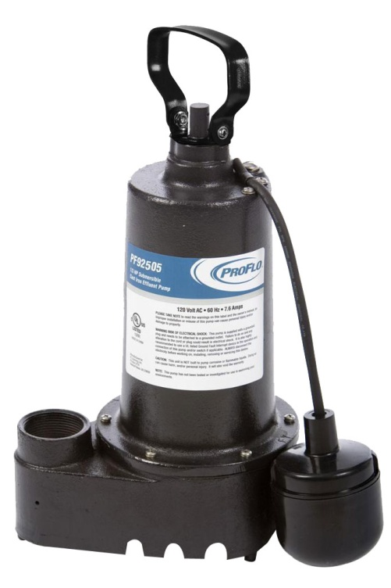
PROFLO EFFLUENT PUMPS
PF92305 - 1/3HP CI EFFLUENT PUMP TETHERED
Split Capacitor Motors for low amp draw and cooler operation
Specifically constructed for operating in caustic environments
Side and bottom intake for clog resistant suction
Cast Iron housing and base
Features trouble free metal vortex impellers
Pump will lift water over 25' vertical height

Slide 12
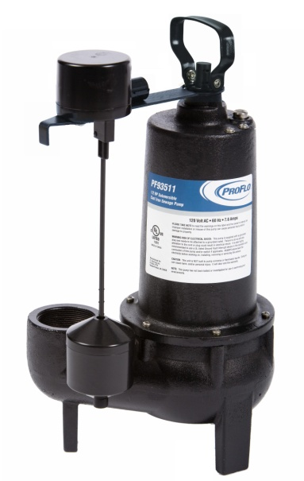
PROFLO SEWAGE PUMPS
236046/PF93511 - 1/2HP CI SEWAGE PUMP W/ VERT SWCH
236045/PF93501 - 1/2HP CI SEWAGE PUMP W/ FLOAT SWCH
1/2 HP Split Capacitor Motor
Cast Iron housing and base
Trouble Free non-clogging metal vortex impeller
2" female iron pipe discharge thread
Will easily handle up to 2" solids
Lifts water to 25'

Slide 13
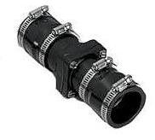
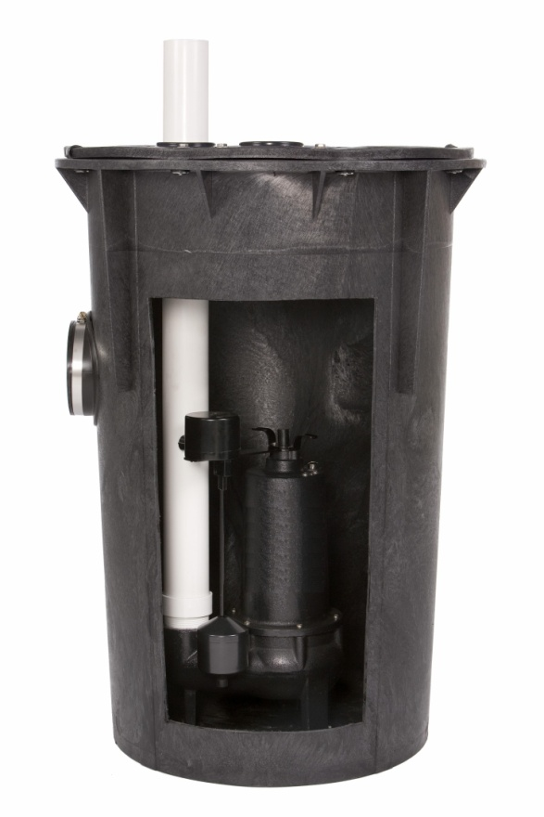
Simplex sewage kits
SYSTEM INCLUDES
Pre assembled kit
1/2 HP Cast Iron Sewage Pump (PF93501/PF93511)
18" x 30" basin with 12 bolt cover (12" or covers?)
2" Full Flow Check valve with rubber boot
BASIN FEATURES
Structural foam construction
Sonic Welded Torque stops
Corrosion resistant
18" x 30" Size
Gasket Sealed, Air Tight Cover
4" Inlet hub
2" Discharge & Vent
Sonic Welded Torque stops
PF93501 / PF93511
PF93015 - Tethered
PF93020 - Vertical
Great for new homes or remodels!

Slide 14
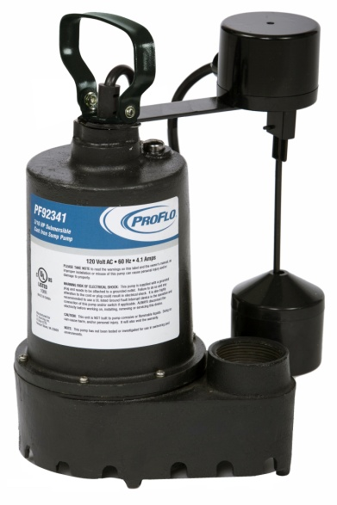
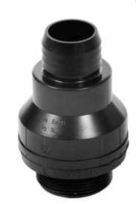
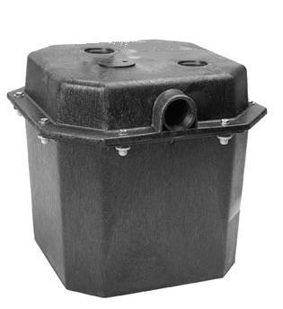
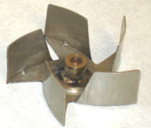
Remote sink drain kit
SYSTEM INCLUDES
1/3 HP Cast Iron sump pump (PF92341)
15" x 15" Poly basin with cover
Universal check valve
236013/PF92017
BASIN FEATURES
Polyethylene structural foam
Corrosion resistant
6 Gallon Capacity, 15"x 15"
Gasket Sealed, Air Tight Cover
1 1/2" Inlet
1 1/2" Outlet & Vent
Preassembled
236020/PF92341

Slide 15
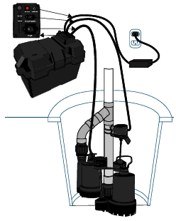
Battery backup pumps
236060/PF92910
Battery Backup System
A Battery Back Up Pump allows your sump pump to operate even with loss of power or failure to the primary pump.
Once the sump pump reaches a certain level the Battery Back Up pump will turn on to discharge the water.
PF92941
Pre-assembled Primary and Battery Backup Sump Kit
PF92952
Pre-assembled Primary and Battery
Backup Sump Kit
*Replacement Parts
available upon request

Slide 16
Battery backup pumps
Why the PROFLO Battery Back Up Pump?
Low amp draw – longer life
Works when power is out
Meets or exceeds industry standards
Simplicity and ease of use
Peace of mind
Uses a sump rather than a bilge pump
Simultaneous operation if needed
Compact design
Durable and efficient
Alarm / control

Slide 17
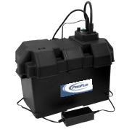
Battery specification compatibility
The PROFLO PF92910 (236060) battery back-up requires the following battery style:
Group 27 marine grade battery
Recommended 160 minute reserve capacity
Acceptable batteries include:
Interstate SRM-27, SRM-27B
Excide NC-27
East Penn MDC-27
Delco M27D6
Everstart 27DC6
Diehard DP27
Duralast 27DP-DL
Zoller P-N10-0761
Length of run time may be increased by using an AGM (Absorbed Glass Mat) battery.
Acceptable AGM batteries examples include:
Optima D27M
Zoller 10-1450 AGM
Notes:
DELETE SLIDE?

Slide 18
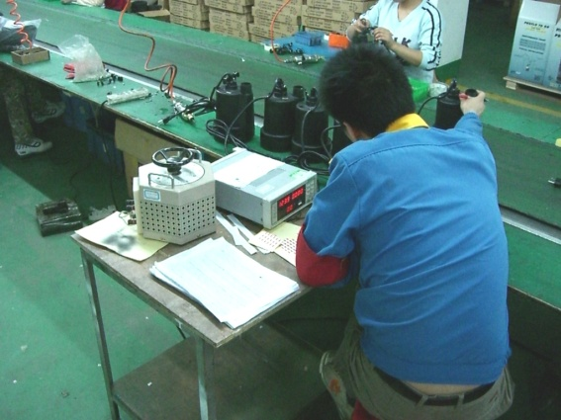
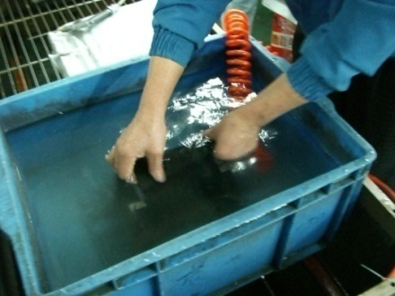
PROFLO PUMP QUALITY ASSURANCE STEPS
In addition to adherence to shop drawings and quality of materials, all production goes through the following steps:
Each motor is 100% tested for continuity, RPM, Amp draw & Hi Pot.
Each assembled pump is air pressurized to 60 PSI under water to check for seal integrity and any weaknesses in construction.
All production is 100% operationally tested underwater to check performance, amp draw under load & seal integrity.
Sampling of each production run is sent to lab for endurance testing. Testing includes: 90,000 on/off switch cycles at 10 ft head. 5,000 hours running under load of 12 ft head.

Slide 19
PROFLO PUMP WARRANTY AND RETURN INFORMATION
PUMP TYPE | WARRANTY PERIOD
Cast Iron Sump Pumps & Sump Pump Kits | 5 year warranty
Thermoplastic Sump & Utility Pumps | 3 year warranty
Sewage Pumps & Sewage Pump kits | 3 year warranty
Effluent Pumps | 3 year warranty
Battery Backup Pumps & Pump Kits | 3 year warranty

Slide 20
troubleshooting
Pump doesn’t start or run
Make sure the pump is plugged in to an outlet
Check for blown fuses or tripped circuit breakers or tripped GFCI outlets
Check the pump by bypassing switch by plugging pump directly into outlet. If the pump works you have a switch malfunction
Check for any obstructions in the impeller
CALL 1-888-6PROFLO (1-888-6356)

Slide 21
TROUBLESHOOTING
Pump starts and stops too often
Check for back flow of water from discharge pipe
Check float switch for proper operation
Pump will not shut off
Make sure switch drops to full down position
Check for obstruction in piping
CALL 1-888-6PROFLO (1-888-6356)

Slide 22
TROUBLESHOOTING
Pump runs and moves little or no water
Make sure check valve is installed in proper direction
Check to ensure discharge pipe is not obstructed
The unit may be air locked. This pump has an anti-air lock device built in. Clean out the air lock
Check intake screen for obstructions.
CALL 1-888-6PROFLO (1-888-677-6356)

Slide 23
SUMP PUMP MAINTENANCE
Always keep outside discharge outlet clean - Especially during winter.
Fill sump pit with water every 6 months
Check pit for trash, stones and debris monthly
After power outage activate pump switch to confirm operation.

Slide 24
For sales assistance please call:
1-800-735-4503 or
or email: sales@lincolnproducts.com
For operational or warranty assistance
please call our pump experts:
1-888-6(PROFLO)
1-888-677-6356

